Slide 1

Python & Flask:
Tic Tac Toe

Slide 2
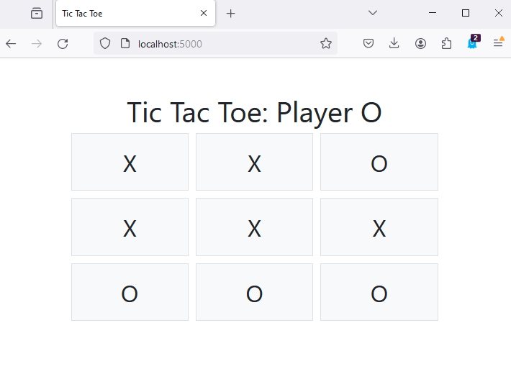
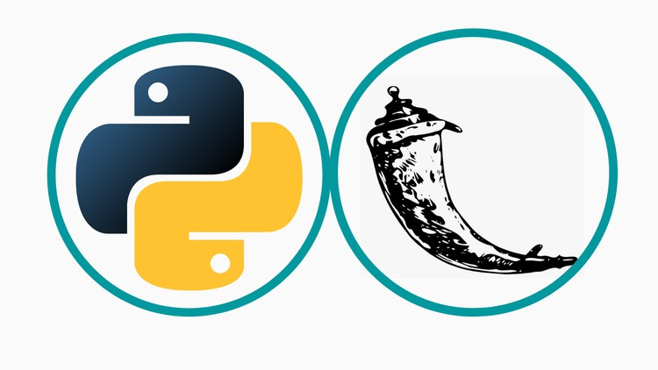
What we are making

Slide 3
How we make this
Programming Basics (Python)
Variables
Data Types
Functions
Web Development: HTML and CSS
HTML
CSS
Flask Framework Basics
Routes
Templates
Server-Client Interaction
Logic Building
Debugging and Testing
Fixing and finding issues

Slide 4
Python Variables
Variables:
Used to store information
Data Types:
Way to store information

Slide 5
Python Data Types
Integer
Float
String
Boolean
Array/List
Dictionary
Set

Slide 6
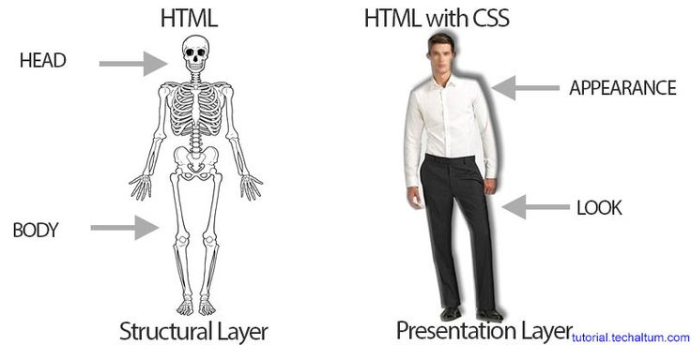
Web Development

Slide 7
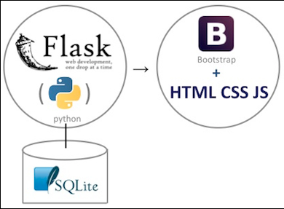
Flask Framework Basics
Flask is a popular micro web framework for Python. It's designed to make it easy to set up simple web applications. Understanding Flask involves grasping three core concepts: routes, templates, and server-client interaction.

Slide 8
Routes
Routes in Flask are URLs or endpoints that define the web address where your application can be accessed. Each route is associated with a Python function.
When a client requests a specific URL, Flask runs the associated function and returns the response.
Routes are created using the @app.route

Slide 9
Templates
Templates are files that contain static data and placeholders for dynamic data. Flask uses Jinja2 templating engine by default.
They allow you to separate the design of your webpage (HTML, CSS), from the Python code, making it easier to design and modify web pages.
You can pass data from your Flask application to these templates, which gets rendered into final HTML to be presented to the user.
Templates are usually HTML files stored in a ‘templates’ folder.

